Slide 1
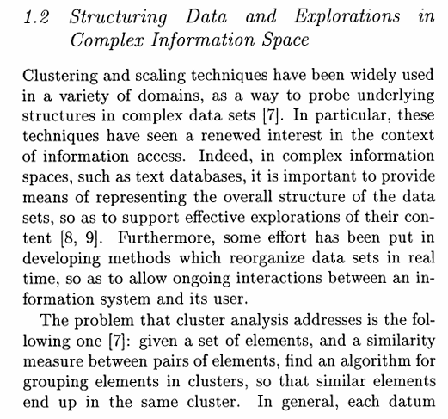
Cluster analysis: Problem
Added by Group 1
Given a set of elements and similarity measure, find an algorithm for grouping elements in clusters
Similar elements end up in the same cluster
Each datum be represented as a point in space
The true number of clusters is unknown
Lumer, E. D. and Faieta, B. 1994. Diversity and adaptation in populations of
clustering ants. In From Animals To Animats3, pp. 501-508.

Slide 2
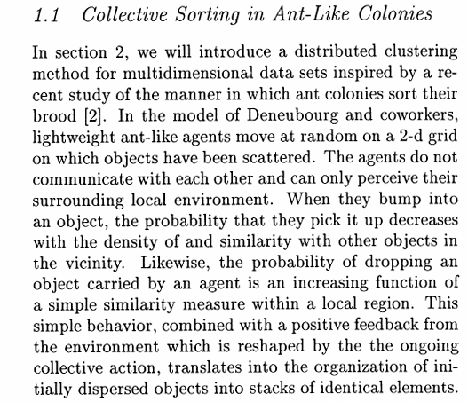
Ant (agent)
Added by Group 1
Behave in a context-dependent manner
Only perceive their surrounding local environment (no communication)
Lumer, E. D. and Faieta, B. 1994. Diversity and adaptation in populations of
clustering ants. In From Animals To Animats3, pp. 501-508.

Slide 3
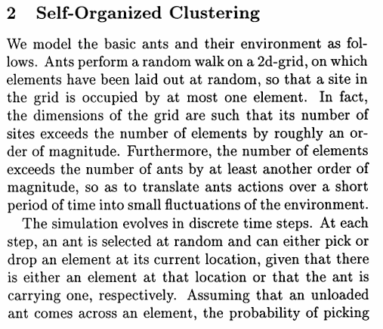
Ants and Environment: Model
Added by Group 1
Ants perform a random walk on a 2d-grid
Elements (Dead ants in Q2 grooming / animals in Q3 clustering) are randomly laid out on the grid
A site in the grid is occupied by at most one elements
Lumer, E. D. and Faieta, B. 1994. Diversity and adaptation in populations of
clustering ants. In From Animals To Animats3, pp. 501-508.

Slide 4
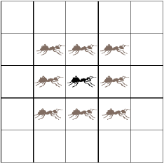
Grooming an ant colony
Result = dead ants collected in one or a few places.
Collecting dead ants together -
If you are not already carrying a dead ant, and you bump into one, pick it up if you see few other dead ants in that area.
If you are carrying a dead ant, drop it if you see many other dead ants in that area.
Dead ant that needs to be segregated
Live ant that wanders and segregates dead ants

Slide 5
Notes:
Two types of dead ants – green and blue

Slide 6
From dead ants to data points
Collecting grains of similar size together
Grains
Data points
Size
2
4
1
Grains with two properties: (size, weight)
Data points with 2 dimensions
2
10
4
8
1
7
Notes:
“Points” because the vectors can be represented as points in n-dimensional space.

Slide 7
“Grooming” a data set
In case of ants, you simply count the number of dead ants, as they all have a single common property – they are all dead.
In case of grains, you calculate the similarity between the grain you want to pick up or drop and of those in that area.
You differentiate between the two viewpoints via the function f. In the former, f is just the perceived fraction of dead ants, and in the latter it is a similarity between the grains.
Collecting similar data points together -
If you are not already carrying a data point, and if bump into one, pick it up if you see few other similar data points in that area.
If you are carrying a data point, drop it if you see many other similar data points in that area.

Slide 8
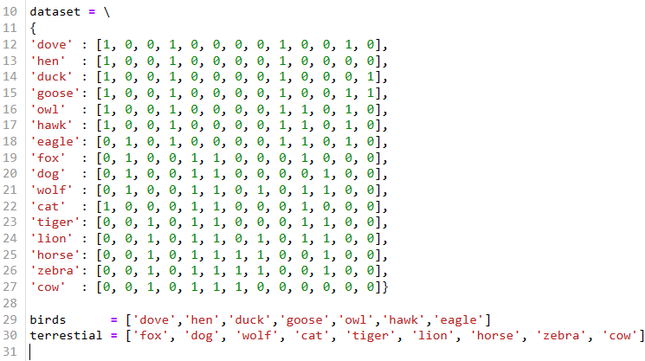
“Clustering” a data set
Added by Group 1
In case of animals, you calculate the similarity between the animal you want to pick up or drop and of those in that area.
You differentiate between the two viewpoints via the function f. In the former, f is just the perceived fraction of dead ants, and in the latter it is a similarity between the grains.
From dataset.py

Slide 9
Distance between a pair of data points
Data Vector X_{i}
X_{i,1} | X_{i,2} | X_{i,3} | … | X_{i,n}
Data Vector X_{j}
X_{j,1} | X_{j,2} | X_{j,3} | … | X_{j,n}

Slide 10
2 | 3
 | 4
 | 5
[2,1]
 | [4,1] | [3,6]
[5,4]
See Similarity.py

Slide 11
Similarity between a data point and its neighborhood
(5. 13)
See Similarity.py
Notes:
The maximum of f(xi) occurs when D(.) = 0 for all xj, in which case f(xi) ~ 1.

Slide 12
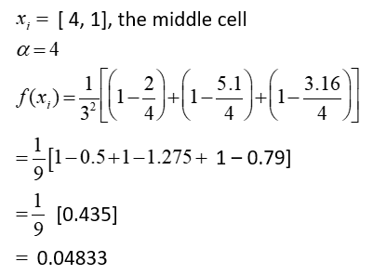
Example: f(x_{i}) for a single data item
[2,1]
 | [4,1] | [3,6]
[5,4]
See Similarity.py
Notes:
f(xi) = Sum of similarities.

Slide 13
Picking-up and Dropping
(5. 11)
(5. 12)
Notes:
Notice that Pp ranges from k1/k1+1 to 1; and Pd ranges from 0 to 1/k2+1.
There is another expression for p_{d} in book – note.

Slide 14
Choosing parameter values
α determines the threshold value of D(x_{i}, x_{j}) beyond which similarity between x_{i} and x_{j} is 0.
k₁ determines the minimum value of p_{p} ≥ 0 .
k₂ determines the maximum value of p_{d} ≤ 1.
(See p.233 and p.259 of your textbook for some example values)

Slide 15
Ant Clustering Algorithm
Create a R x C grid
Strew your data points across the grid
Randomly place N ants in the grid, with no more than one ant occupying a cell
Do the following for a given maximum number of iterations:
For every ant in the grid, in their respective cells:
If ant is not carrying a data point and its cell contains one, x_{i}, then
Compute f(x_{i})
Pick up item with probability P_{p}(x_{i})
If ant is carrying a data point x_{i} and its cell is free, then
Compute f(x_{i})
Drop item with probability P_{d}(x_{i})
Walk ant to a random neighboring cell that is not occupied by another ant
Notes:
The cell an ant can walk to should only not contain another ant, but can of course contain data points -- that’s how the ant sorts them out, by picking-up or dropping the data point in the cell where it is standing.

